Slide 1
CHAPTER 3
IMPROPER INTEGRAL

Slide 2
3. IMPROPER INTEGRALS
3.1. Type 1: Infinite Intervals
3.2. Type 2: Discontinuous Integrands
3.3. Comparison Test for Improper Integrals

Slide 3
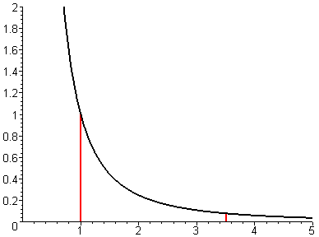
3.1 Type 1: Infinite Intervals
Consider the area A of the infinite region S under the curve y=1/x², above the x-axis and on the right of x=1. At a first look, it seems that A is infinite.

Slide 4
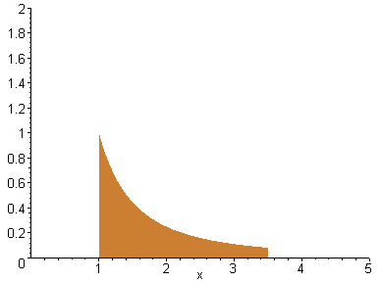
However if we look at the part of S on the left of the line x=t. then
Moreover
So we say that the area of the infinite region S is 1, and

Slide 5
Definition of Improper Integral of Type 1.
(a) If exists for all t ≥ a , then
provided the limit exists (as a finite number)
(b) If exists for all t ≤ b , then
provided the limit exists (as a finite number).
We say that the improper integrals
and are convergent.
Otherwise we say that they are divergent

Slide 6
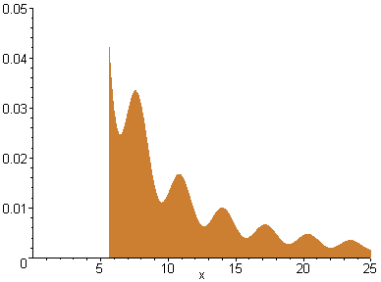
Definition of Improper Integral of Type 1.
(c) If both and are convergent, then we define
the value on the right hand side does not depend on the choice of a
These improper integrals may be interpreted as areas of infinite regions if f(x) ≥ 0

Slide 7
Example. Is
convergent or divergent?
Solution. We have
Hence the improper integral is divergent.
Note that the function 1/x does not approach 0 fast enough to make the integral convergent, in contrary to the function 1/x²

Slide 8
Example. Evaluate
Solution. We will integrate by part the function xe^{x} from t to 0, with u=x, dv=e^{x}dx. We have du=dx, v=e^{x}
Recall that e^{t} → 0 as t → -∞.
Moreover l'Hospital's Rule gives
Therefore

Slide 9
Example. Evaluate
Solution. We have
On the other hand
Therefore

Slide 10
Example.
is convergent for what value of p?
Solution. The integral is divergent for p = 1.
If p ≠ 1, then we have
If p>1, then p-1>0. So t ^{p-1} → ∞ as t → ∞. Therefore
Hence the integral is convergent

Slide 11
Example.
is convergent for what value of p?
Solution.
If p<1, then p-1<0. So
Hence the integral is divergent. In summary
is convergent for p>1 and divergent for p ≤1

Slide 12
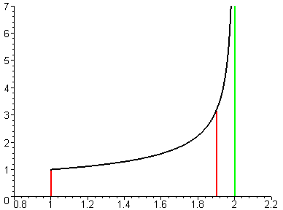
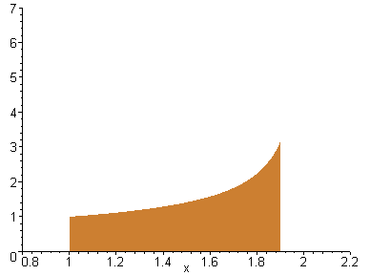
3.2 Type 2: Discontinuous Integrands
Suppose f is continuous on [a, b) and x=b is a vertical asymptote. Consider the unbounded region S under the graph of f, above the x-axis and between a and b.
The area of the part of S between a and t (gold area) is
If A(t) → A as t → b⁻ , then the area of the region S is A

Slide 13
Definition of Improper Integral of Type 2.
(a) If f is continuous on [a, b) and discontinuous at b then
provided the limit exists (as a finite number)
(b) If f is continuous on (a, b] and discontinuous at a then
provided the limit exists (as a finite number)
We say that the improper integrals
is convergent.
Otherwise we say that it is divergent

Slide 14
Definition of Improper Integral of Type 2.
(c) If f is discontinuous at c with a < c < b and both
and are convergent,
then we define
These improper integrals may be interpreted as areas of unbounded regions if f(x) ≥ 0

Slide 15
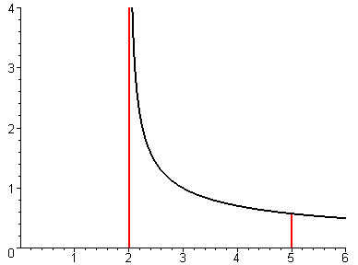
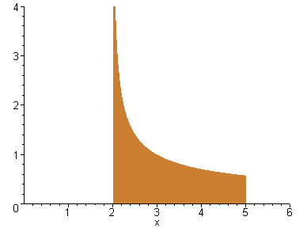
Example. Evaluate
Solution. The integrand has a vertical asymptote x=2
Thus the improper integral is convergent and may be interpreted as the area of the unbounded gold region

Slide 16
Example. Evaluate
Solution. We have
However this calculation is not correct since the function 1/(x-1) has the vertical asymptote x = 1. In fact
Hence the improper integral is divergent

Slide 17
Example. Evaluate
Solution. The integral is improper since x = 0 is a vertical asymptote. We have
We integrate by part with u = ln x, dv=dx. We have du=dx/x, v=x

Slide 18
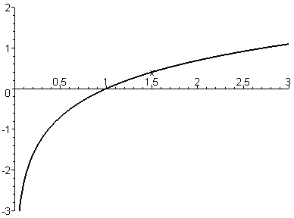
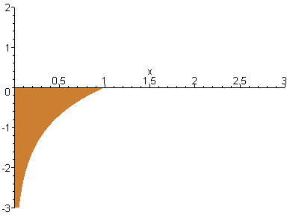
By l'hospital's Rule we have
Therefore
Thus the improper integral is convergent and may be interpreted as the (-)area of the unbounded gold region
-

Slide 19
3.3. A Comparison Test for Improper Integrals
Comparison Theorem. Suppose f and g are continuous such that f(x) ≥ g(x) ≥ 0 for x ≥ a
(a) If is convergent then
is convergent
(b) If is divergent then
is divergent

Slide 20
Example. Show that is convergent
Solution. The indefinite integral is not an elementary function, so we use the Comparison Test. We have
The first integral is an ordinary integral.
On the other hand –x² ≤ -x for 1 ≤ x.
Therefore the integral is convergent by the Comparison Test if we can prove the convergence of
We have indeed

Slide 21
Example. The integral is divergent
by the Comparison Test because
And the integral is divergent

Slide 22
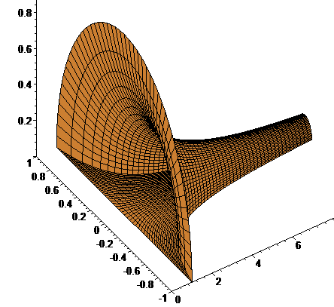
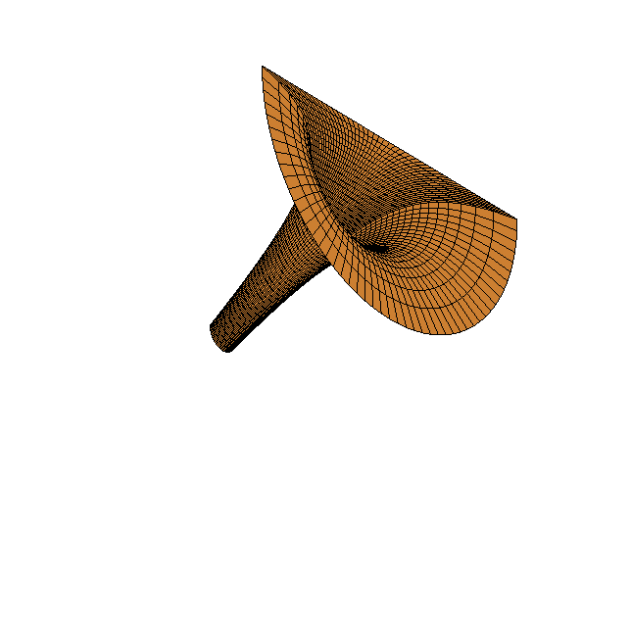
Example. Rotate the region under the curve y = 1/x on the right of the line x = 1 about rhe x-axis we get
Q2. To paint the surround area, what is the total amount of paint needed?
Q1. To fill the container, what is the total amount of paint needed?

